Slide 1
ASPECTS OF ROAD ACCIDENT INVESTIGATION
Urban Resource Centre
March 20th , 2014
Dr. Mir Shabbar Ali
Professor (Transportation Engineering)
DEPARTMENT OF URBAN AND INFRASTRUCTURE ENGINEERING
NED University of Engineering and Technology, Karachi

Slide 2
Presentation Outline
Engineering Approach to Road Crash analysis
Karachi scenario
Safe system Framework
Road safety design and traffic management
Conclusions and Recommendations
Department of Urban & Infrastructure Engineering

Slide 3
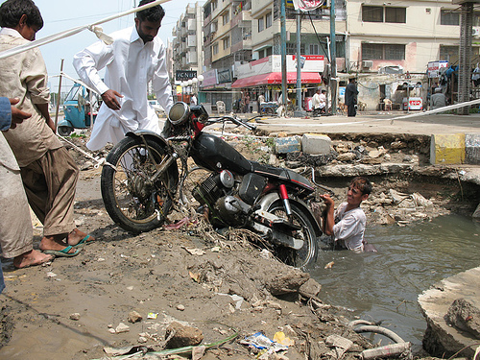
Road Crash is NOT AN ACCIDENT!
ACCIDENT occurs when
System Demands more than
User can Perform
User Performance
Demand /
Performance
System Demand
Time / Location
Department of Urban & Infrastructure Engineering

Slide 4
Accident Components
System Demand Indicators
Road Design Road Furniture (Traffic Signs) Maintenance (Skid Resistance)
Department of Urban & Infrastructure Engineering

Slide 5
Accident Components
User Performance Indicators
Driver Training Education Attitudes | Vehicle Breaking Roadworthiness Speed
Department of Urban & Infrastructure Engineering

Slide 6
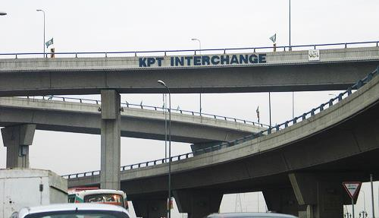
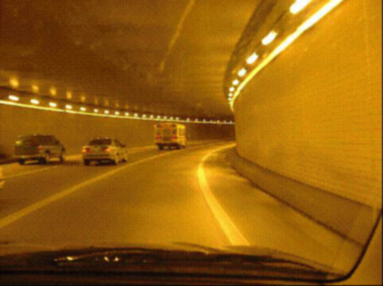
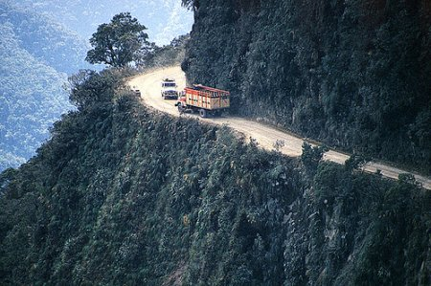
High system Demand Locations

Slide 7
Logical approach to Road Safety Issue
Road Traffic injury problem is man made – so it must have a man made solution
Traffic Management
Road
Vehicles
Highest possible tolerance for all ranges of HUMAN PERFROMANCE

Slide 8
Objectives
explain the importance of research and research capacity in road traffic injury prevention;
explain ethical issues in research on road traffic injury prevention;
evaluate the quality of data and evidence on road traffic injury prevention in the trainee's own country.

Slide 9
Why collect reliable data on road traffic injuries?
Describe the burden of road traffic injuries.
Assess risk factors.
Establish priorities and allocate resources for prevention.
Develop and evaluate interventions.
Provide information for policy-makers and decision-makers.
Raise awareness.

Slide 10
What are the main sources and types of data?
Number of road traffic incidents, fatalities and injuries
Type of road users involved
Age and sex of casualties
Type of vehicles involved
Police assessment of causes
Location and sites of crashes
Prosecutions
Cause/responsibility e.g. alcohol, speed, vehicle factors
Police

Slide 11
What are the main sources and types of data?
Health facility settings
Fatal and non-fatal injuries
Age and sex of casualties
Road user categories
Cost of treatment
Alcohol or drug involvement
Severity and type of injuries
Outcome e.g. disability
Insurance firms
Fatal and non-fatal injuries
Damage to vehicles
Cost of claims
Cost to victims

Slide 12
What are the main sources and types of data?
Government departments and agencies
Population denominators
Income and expenditure data
Health indicators
Exposure data
Pollution data
Energy consumption
Literacy levels

Slide 13
What are the main sources and types of data?
Special interest groups
Number of road traffic incidents, fatal and non-fatal injuries
Type of road users involved
Age and sex of casualties
Type of vehicles involved
Interaction of victims with vehicles
Causes
Location and sites of crashes
Social and psychological impacts
Interventions and evaluation
Damage and losses
Legal issues, insurance claims
Operational data
e.g.
research institutes, NGOs, transport unions, transport companies, consulting firms

Slide 14
How are data on road traffic injuries collected?
Injury surveillance systems: set up in hospitals and other appropriate institutions for ongoing systematic collection, analysis, interpretation and dissemination of information.
Community-based surveys: data collected from households and/or communities.
Academic studies on selected topics: provide information on specific topics and may include case-control studies, in- depth crash analysis and complementary investigations.

Slide 15
It is not enough just to collect data…
…link and share
Data collected and stored by a range of agencies.
Ensure access, harmonization and linkage between different data sources and users to obtain maximum value from the information.
Tackle the problem of coordination and sharing of information among different users.

Slide 16
Analyse, disseminate and use information
Analyse data to answer questions on magnitude, patterns, risk factors, interventions and their effectiveness.
Several software packages to use e.g. Epi Info and SPSS.
Ensure that you share and disseminate information with colleagues, researchers, policy-makers and the public.
Use various strategies to disseminate information: journal articles, reports, policy briefs, fact sheets, web page and newspapers.

Slide 17
Indicators to measure the problem
Fatalities per vehicle-kilometre travelled
Number of deaths per billon kilometres travelled
Description
- Useful for some international comparisons, decreases with motorization
- Does not take into account non-motorized travel
Use and limitations

Slide 18
Indicators to measure the problem
Disability-adjusted life years (DALYs)
Measures healthy life years lost to disability and mortality. One disability-adjusted life year lost is equal to one year of healthy life lost, either due to premature death or disability
Description
Use and limitations
- DALYs combine both mortality and disability
- DALYs do not include all the health consequences associated with injury such as mental health consequences

Slide 19
Continue to conduct research and invest in research capacity
A basis for generating data and evidence.
A basis for informed decision-making.
Develop national research capacity.
National and community research vital to identify local problems.
Independence of research essential to ensure quality and minimize political pressure.

Slide 20
Key points
Evidence is needed for decision-making and planning.
Reliable data and evidence are essential.
Police departments and hospitals are major sources of road traffic injury data.
Ensure access, harmonization and linkages between different data sources and users.
Several problems and concerns with road traffic injury data.
A need for continuous research and research capacity development.

Slide 21
Questions to think about
a) Based on your experience, identify any two major decisions you have made in the past regarding road traffic injury prevention. Explain what was the basis for making these decisions. Did you consider the evidence base when making the two decisions?
b) Discuss the prevailing situation with regard to coordination and sharing of data among agencies that collect information on road traffic injuries in your country.
If you identify limited coordination and linkage, indicate steps that can be taken to improve this situation.

Slide 22
Questions to think about
c) There is a general concern about the difference between evidence and policy implementation. Does this situation exist in your country with respect to road traffic injury prevention? If so, what leads to this? What steps can be taken to address this situation?
d) Underreporting of both death and injuries is a major global problem affecting not only low-income and middle- income countries but also high-income countries. What is the situation in your country? What efforts have been made to address this problem?

Slide 23
KARACHI SCENARIO Accident Contributing Factors
Potholes
Cracks on the road
Wet surface and Oil spillage
Sharp horizontal curves
Undivided roadways
Uneven road surfaces
Under construction area
Improper Placement of commercial signs

Slide 24
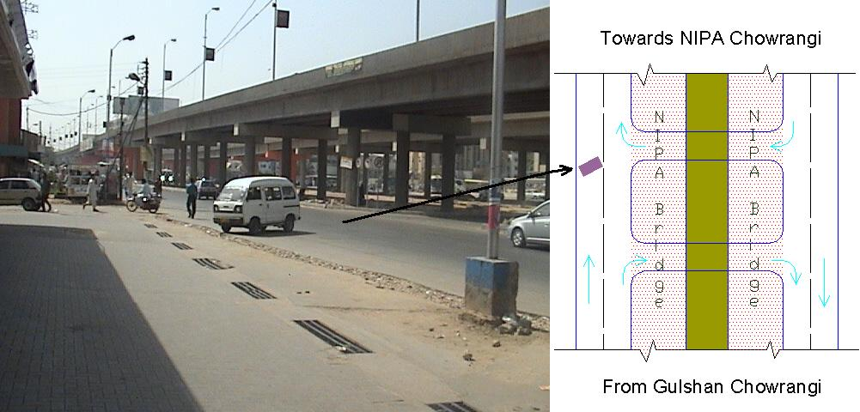
Misusing U-turn
Department of Urban & Infrastructure Engineering

Slide 25
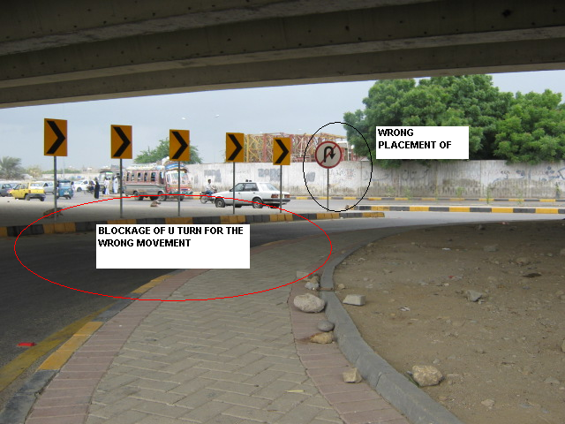
Wrong Movements
Temporary due to under constructed area, this u turn has been blocked through Enforcement in order to avoid injuries due to wrong way
Department of Urban & Infrastructure Engineering
Date: 16/11/2009

Slide 26
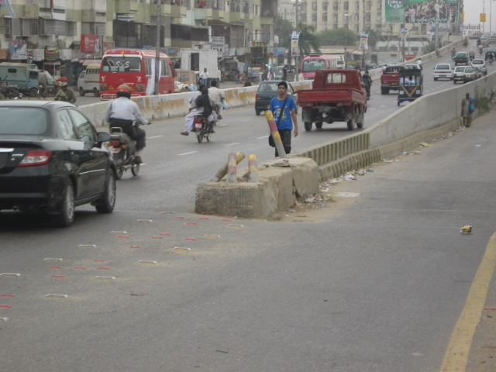
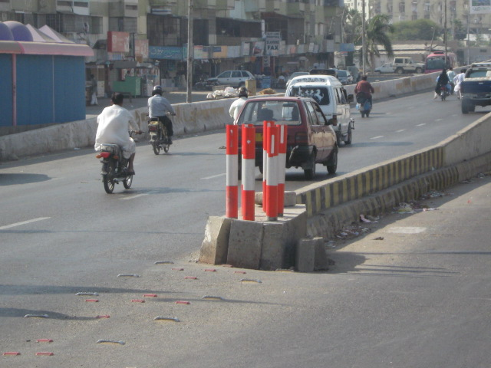
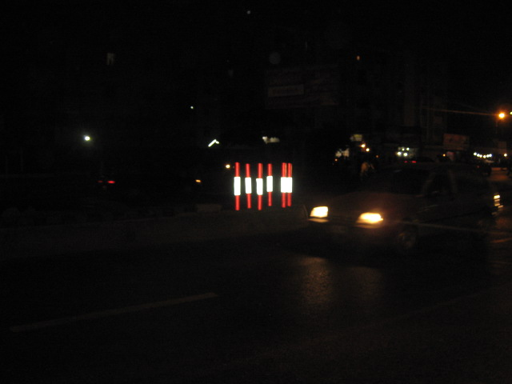
Channelization markings - Rashid Minhas Road

Slide 27
Shaheed-e-millat Expressway
PROBLEMS
Presence of Curves (Skidding Issue)
Three Level Road / Express Way
High Speed Express Way
Pedestrian Road Crossing
Department of Urban & Infrastructure Engineering
Date: 16/11/2009

Slide 28
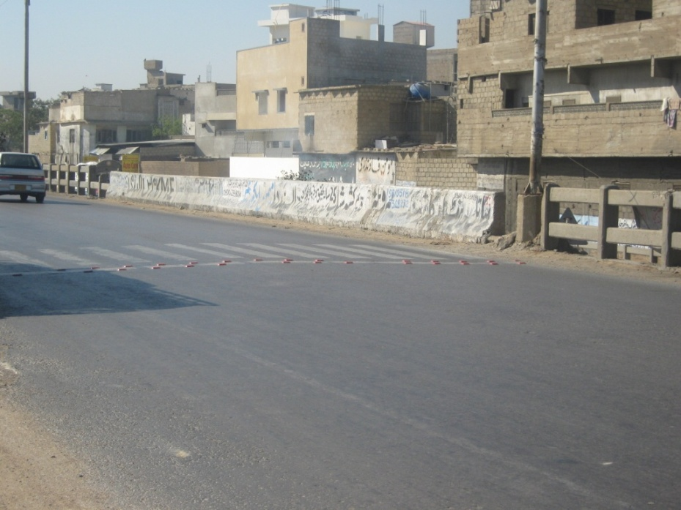
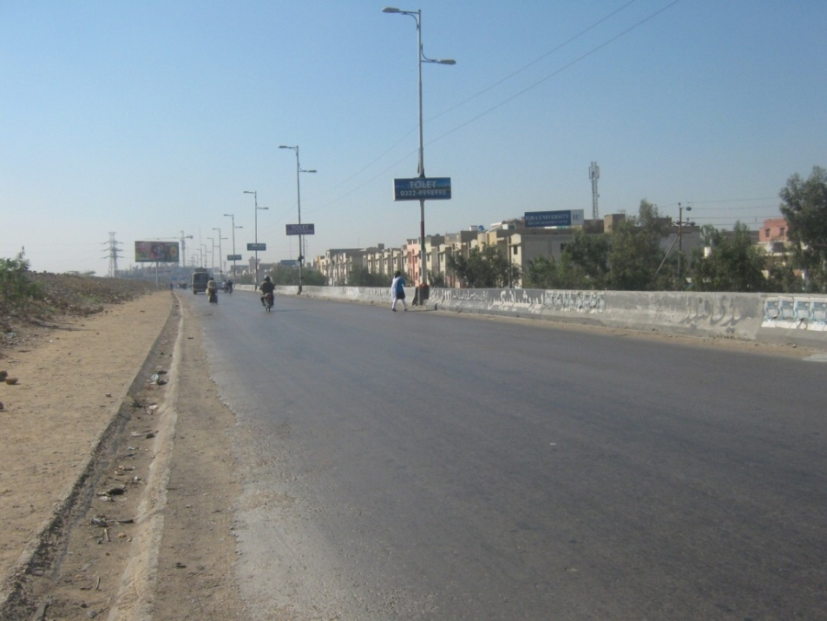
Shaheed-e-Millat Expressway
BEFORE AFTER
Previously safety Fence was provided on this road but now it has been replaced with the solid concrete safety wall throughout the length.
Signage works has also been improved on Shaheed-e-Millat Express way

Slide 29
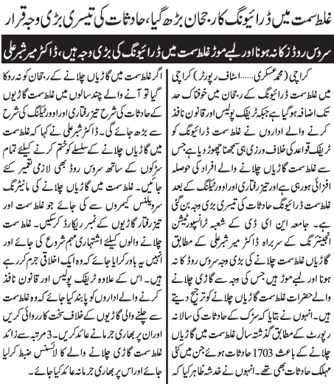
Media support possible and useful

Slide 30
Setting the Goal
WHO-vision

Slide 31
Conclusions
Road crash occurs when System Demand is higher than the User Performance
Speed management very important in Safe System approach
Improvements to infrastructure can provide Safe System outcomes
Primary treatments provide sustainable solutions
Supporting treatments provide immediate relief
Department of Urban & Infrastructure Engineering

Slide 32
Recommendations
In-depth analysis of All Traffic components will provide success to any road safety measure
Detailed Engineering analysis and treatment of Black Spots must be carried out
Emerging technology must be utilized in developing Road safety models and effective traffic management
Department of Urban & Infrastructure Engineering

Slide 33
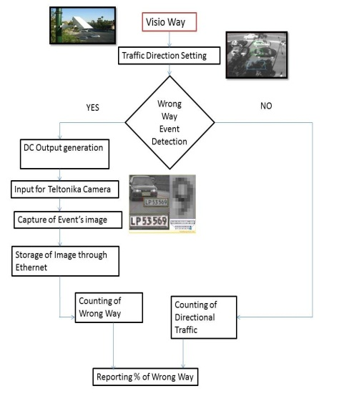
The way forward

Slide 34
Thank you

